Slide 1
ER Model
3

Slide 2
Today’s Agenda
ER Data Model

Slide 3
Entity set
Entity Set
An entity set is a set of entities of the same type that share the same properties or attributes. The set of all person who are customers at a given bank can be defined as the entity set customer. Similarly the entity set loan might represent the set of all loans given by a particular bank.

Slide 4
Difference between entity, entity set and entity type
1. Entity : An entity is a thing in a real-world with independent existence. An entity can exist independently and is distinguishable from other objects. It can be identified uniquely.
E.G.
A student with a particular roll number is an entity.
A company with a particular registration number is an entity.

Slide 5
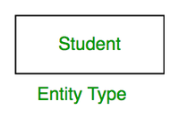
Cont…
Entity Type : It refers to the category that a particular entity belongs to.
Example :
A table named student in a university database.
A table named employee in a company database.
Note :
The category of a particular entity in the relation in RDBMS is called the entity type.
It is represented by the name of the table and its schema.

Slide 6
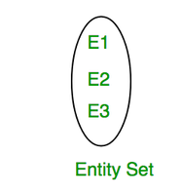
Cont…
3. Entity Set : An entity set is a collection or set of all entities of a particular entity type at any point in time. The type of all the entities should be the same.
Example :
The collection of all the students from the student table at a particular instant of time is an example of an entity set.
The collection of all the employees from the employee table at a particular instant of time is an example of an entity set.
Note: The collection of all the entities in the relation of RDBMS is called an entity set.

Slide 7
Example
Entity : Each row is an entity.
Example :
1 Avi 19 M
Entity Type : Each entity belongs to the student type. Hence, the type of entity here is a student.
Entity Set : The complete data set of all entities is called entity set. For the given table, the records with student id 1, 2, 3, 4 are the entity set.
Table Name : Student
Student_ID | Student_Name | Student_Age | Student_Gender
1 | Avi | 19 | M
2 | Ayush | 23 | M
3 | Nikhil | 21 | M
4 | Riya | 16 | F

Slide 8
Type of attribute
Single attribute
Composite attribute
Single valued attribute
Multi valued attribute
Base attribute or store attribute
Derived attribute
Key attribute

Slide 9
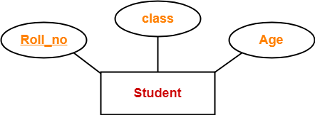
Simple attribute
All the attributes are simple attributes as they can not be divided further.

Slide 10
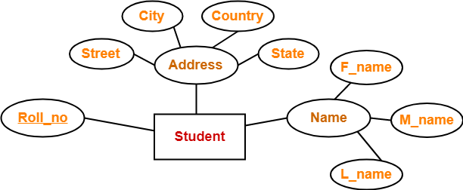
Composite Attributes
Composite attributes are those attributes which are composed of many other simple attributes.

Slide 11
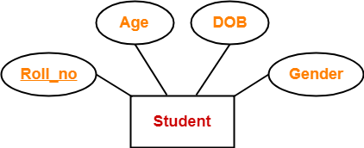
Single-Valued Attribute
Single valued attributes are those attributes which can take only one value for a given entity from an entity set.

Slide 12
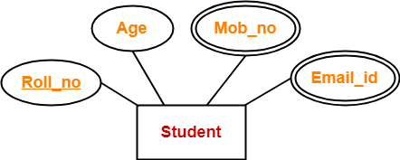
Multi Valued Attributes
Multi valued attributes are those attributes which can take more than one value for a given entity from an entity set.

Slide 13
Base/Store attribute
Stored attribute is an attribute which are physically stored in the database.
Assume a table called as student. There are attributes such as student_id, name, roll_no, course_Id. We cannot derive value of these attribute using other attributes. So, these attributes are called as stored attribute.

Slide 14
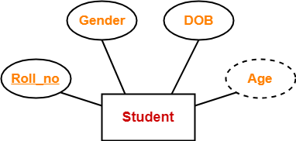
Derived Attributes
Derived attributes are those attributes which can be derived from other attribute(s).

Slide 15
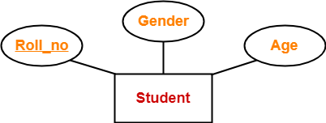
Key attribute
Key attributes are those attributes which can identify an entity uniquely in an entity set. Here, the attribute “Roll_no” is a key attribute as it can identify any student uniquely.

Slide 16
Relationship
We are related to things around us in some or the other way. We are related to our family, friends, etc. and these relationships are of different kinds. For example, you and your father are related. There is a parent-child relationship between you. You have only one father but he may have many children. You and your siblings are related. You and your teacher are related. The teacher teaches you as well as many other students. You also study from different teachers.
A relationship represent an association between two or more entities.

Slide 17
Relationship
We are related to things around us in some or the other way. We are related to our family, friends, etc. and these relationships are of different kinds. For example, you and your father are related. There is a parent-child relationship between you. You have only one father but he may have many children. You and your siblings are related. You and your teacher are related. The teacher teaches you as well as many other students. You also study from different teachers.
A relationship represent an association between two or more entities. Any association between two entity types is called a relationship. Entities take part in the relationship. It is represented by a diamond shape.
For example, A teacher teaches students. Here, "teaches" is a relationship and this is the relationship between a Teacher entity and a Student entity.

Slide 18

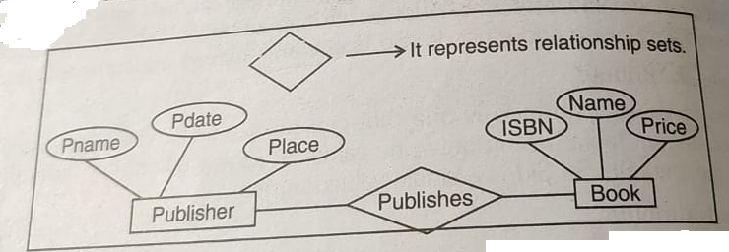
Relationship
We are related to things around us in some or the other way. We are related to our family, friends, etc. and these relationships are of different kinds. For example, you and your father are related. There is a parent-child relationship between you. You have only one father but he may have many children. You and your siblings are related. You and your teacher are related. The teacher teaches you as well as many other students. You also study from different teachers.
A relationship represent an association between two or more entities. Any association between two entity types is called a relationship. Entities take part in the relationship. It is represented by a diamond shape.
For example, A teacher teaches students. Here, "teach/teaches" is a relationship and this is the relationship between a Teacher entity and a Student entity.

Slide 19
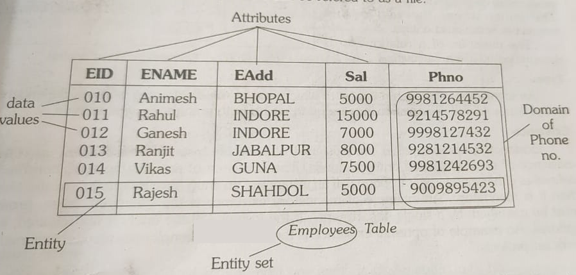
Relationship

Slide 20
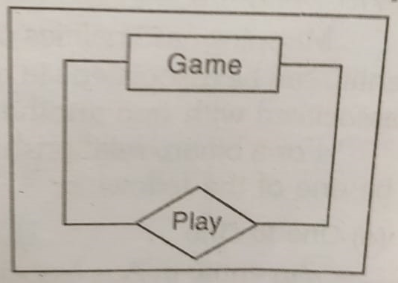
Degree of Relationship
The degree of a relationship is the number of entities associated with the relationship. The n-array relationship is the general form for degree n. Special cases are the binary and ternary where the degree is 2 and 3 respectively.
Unary Relationship

Slide 21
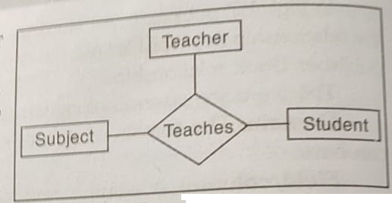
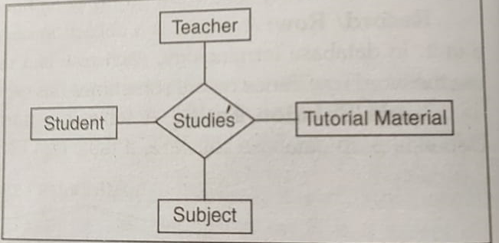
Degree of Relationship
Binary Relationship
Ternary Relationship
Quaternary Relationship

Slide 22
Direction, Type and Existence
Direction: The direction of a relationship indicates the originating entity of a binary relationship. The entity from which a relationship originates is the parent entity. The entity where the relationship terminates is the child entity. The direction of a relationship is determined by its connectivity.
Type: An identifying relationship is one in which one of the child entity is also a dependent entity. A non-identifying relationship is one in which both entities are independent.
Existence: Existence denotes whether the existence of an entity instance is dependent upon the existence of another related entity instance. It is either mandatory or optional.

Slide 23
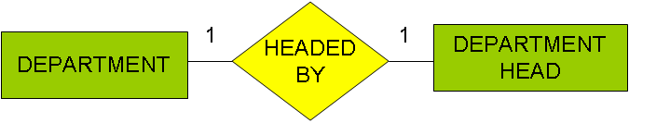
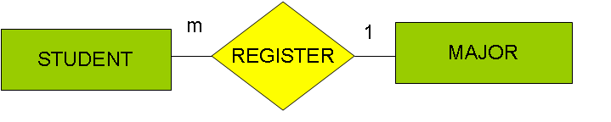
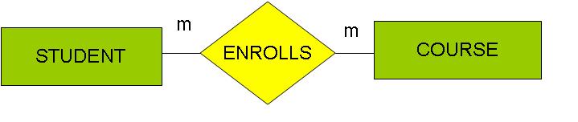
Types of relationships/ Mapping Cardinalities
One to one
One to many
Many to one
Many to many
1
has
m
College
University

Slide 24
Participation constraints
There are two ways by which an entity can participate in a relationship.
Total
Partial
An entity set E in a relationship set R is said to be total, if every entity in E participates in at least one relationship in R. If only some entities in E participate in relationship in R, the participation of entity set E in relationship R is said to be partial.

Slide 25
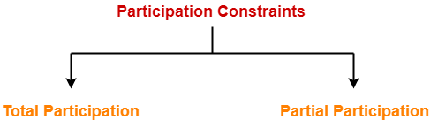
Participation constraints
Two ways are:

Slide 26
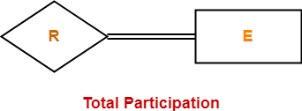
Total Participation
It specifies that each entity in the entity set must compulsorily participate in at least one relationship instance in that relationship set. That is why, it is also called as mandatory participation. Total participation is represented using a double line between the entity set and relationship set.

Slide 27

Example
Here, Double line between the entity set “Student” and relationship set “Enrolled in” signifies total participation.
It specifies that each student must be enrolled in at least one course.

Slide 28
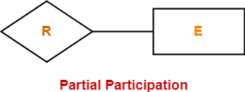
Partial Participation
It specifies that each entity in the entity set may or may not participate in the relationship instance in that relationship set.
That is why, it is also called as optional participation.
Partial participation is represented using a single line between the entity set and relationship set.

Slide 29
Example
Here,
Single line between the entity set “Course” and relationship set “Enrolled in” signifies partial participation.
It specifies that there might exist some courses for which no enrollments are made.
Relationship between Cardinality and Participation Constraints-
Minimum cardinality tells whether the participation is partial or total.
If minimum cardinality = 0, then it signifies partial participation.
If minimum cardinality = 1, then it signifies total participation.
Maximum cardinality tells the maximum number of entities that participates in a relationship set.

Slide 30


